Slide 1
WebSocket
Parker zhou
parkerzho2010@gmail.com

Slide 2
Why Not HTTP?
HTTP is not duplex, each response from server must have a corresponding request from client(browser)
HTTP can not support Real-time application(monitor\chat\stock)
ajax-long-pulling and Comet are both waste server and bandwidth, and also have latency

Slide 3
Why WebSocket?
After create a connection, sever is able to send message to client at any time, in other words, client can listen the message from server, without any additional request. Same as client.
Sounds like socket, but implemented in application layer.

Slide 4
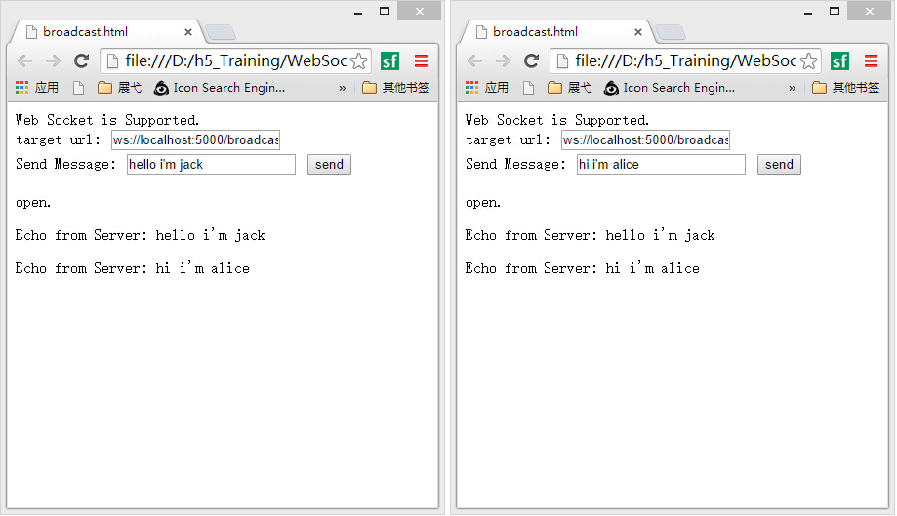
Quick Example
Chat example

Slide 5
WebSocket URI
ws-URI = "ws:" "//" host [ ":" port ] path [ "?" query ]
wss-URI = "wss:" "//" host [ ":" port ] path [ "?" query ]

Slide 6
Handshake
GET /chat HTTP/1.1
Host: example.com
Connection: Upgrade
Sec-WebSocket-Protocol: sample
Upgrade: websocket
Sec-WebSocket-Version: 13
Sec-WebSocket-Key: 7cxQRnWs91xJW9T0QLSuVQ==
Origin: http://example.com
HTTP/1.1 101 WebSocket Protocol Handshake
Upgrade: websocket
Connection: Upgrade
Sec-WebSocket-Accept: 7cxQRnWs91xJW9T0QLSuVQ==
WebSocket-Protocol: sample

Slide 7
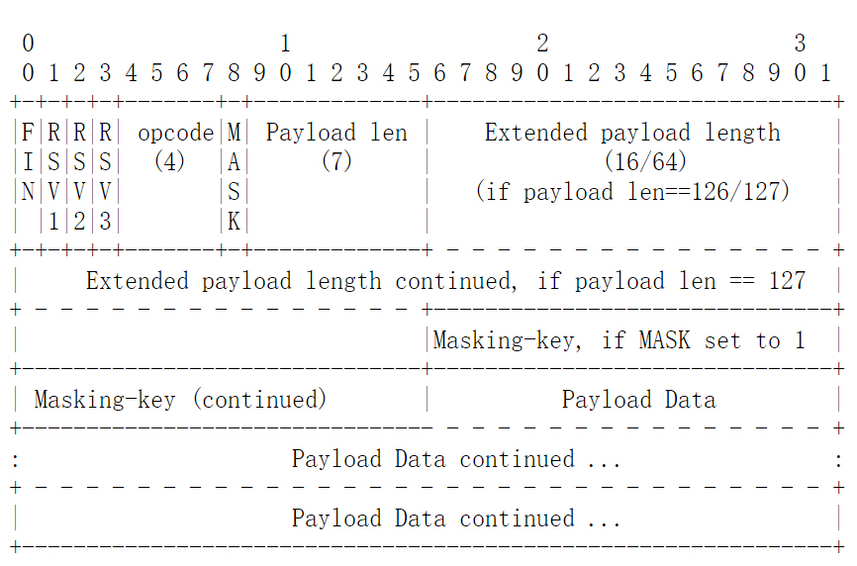
Data Frame
Notes:
FIN: 1 bit
Indicates that this is the final fragment in a message. The first fragment MAY also be the final fragment.
RSV1, RSV2, RSV3:
1 bit each MUST be 0 unless an extension is negotiated which defines meanings for non-zero values. If a nonzero value is received and none of the negotiated extensions defines the meaning of such a nonzero value, the receiving endpoint MUST _Fail the WebSocket Connection_.
Opcode:
4 bits Defines the interpretation of the payload data. If an unknown opcode is received, the receiving endpoint MUST _Fail the WebSocket Connection_. The following values are defined.
* %x0 denotes a continuation frame
* %x1 denotes a text frame
* %x2 denotes a binary frame
* %x3-7 are reserved for further non-control frames
* %x8 denotes a connection close
* %x9 denotes a ping
* %xA denotes a pong
* %xB-F are reserved for further control frames
Mask: 1
bit Defines whether the payload data is masked. If set to 1, a masking key is present in masking-key, and this is used to unmask the payload data as per Section 5.3. All frames sent from client to server have this bit set to 1.
Payload length: 7 bits, 7+16 bits, or 7+64 bits
The length of the payload data, in bytes: if 0-125, that is the payload length. If 126, the following 2 bytes interpreted as a 16 bit unsigned integer are the payload length. If 127, the following 8 bytes interpreted as a 64-bit unsigned integer (the most significant bit MUST be 0) are the payload length. Multibyte length quantities are expressed in network byte order. Note that in all case the minimal number of bytes MUST be used to encode the length, for example the length of a 124 byte long string can't be encoded as the sequence 126, 0, 124. The payload length is the length of the extension data + the length of the application data. The length of the extension data may be zero, in which case the payload length is the length of the application data.
Masking-key: 0 or 4 bytes
All frames sent from the client to the server are masked by a 32- bit value that is contained within the frame. This field is present if the mask bit is set to 1, and is absent if the mask bit is set to 0.

Slide 8
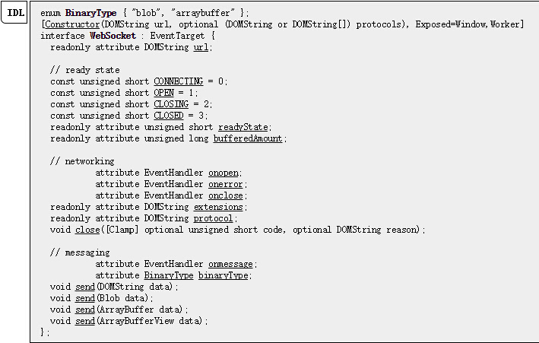
WebSocket Interface

Slide 9
Detail Example
See how to write a simple websocket server using python(asyncore)
See how to use websocket interface in javascript client

Slide 10
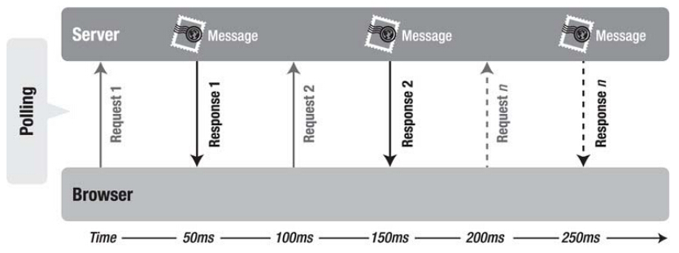
HTTP vs Websocket
Latency
More bandwidth

Slide 11
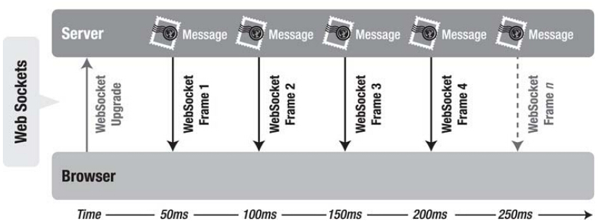
HTTP vs Websocket
Real-time
Simple data frame

Slide 12
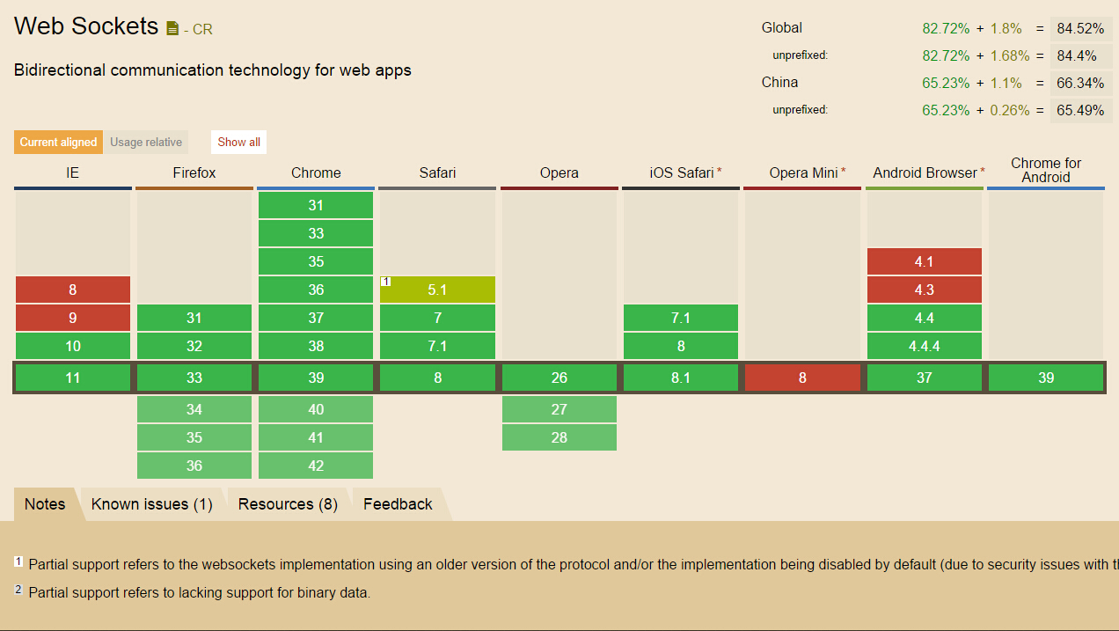
Browser Support

Slide 13
References:
The WebSocket protocol draft-ietf-hybi-thewebsocketprotocol-17
(W3C)The WebSocket API

